Slide 1
Chapter 3
Determinants and Diagonalization
Notes:
The determinant of a matrix tell us whether or not the matrix is invertible, can be used to find a formula for the inverse of a matrix, and give us a method for solving linear equations.
Diagonalization help us find A^{n} with every n.

Slide 2
Contents
3.1. The cofactor Expansion
3.2.Determinants and Matrix Inverses
3.3. Diagonalization and Eigenvalues
3.4. An Application to Linear Recurrences

Slide 3
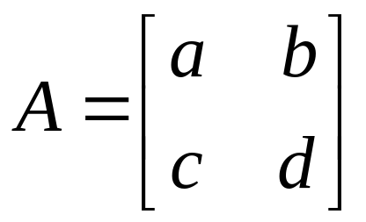
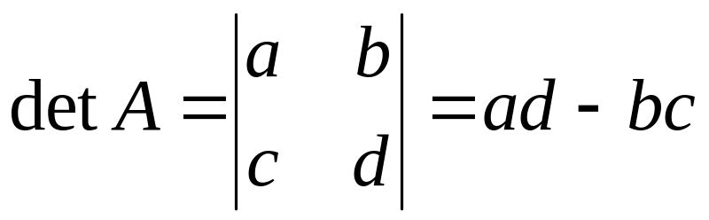
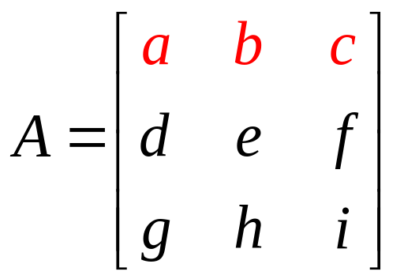
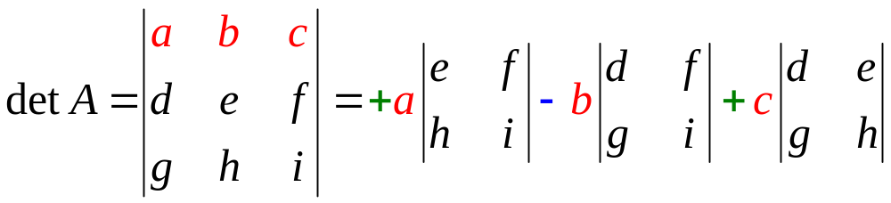
3.1. The Cofactor Expansion
If A=[a] then the determinant of A, denoted by detA=a
If A is an 2x2 matrix then
If A is an 3x3 matrix then the determinant of A is defined by
+
-
+
Notes:
Sarrus

Slide 4
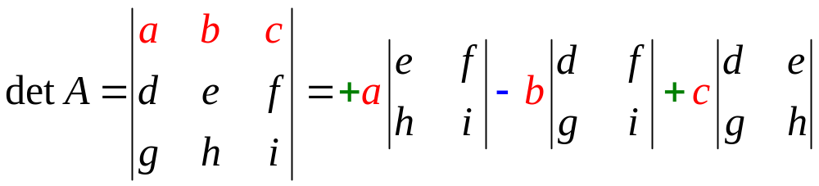
The determinant of 3x3 matrix

Slide 5
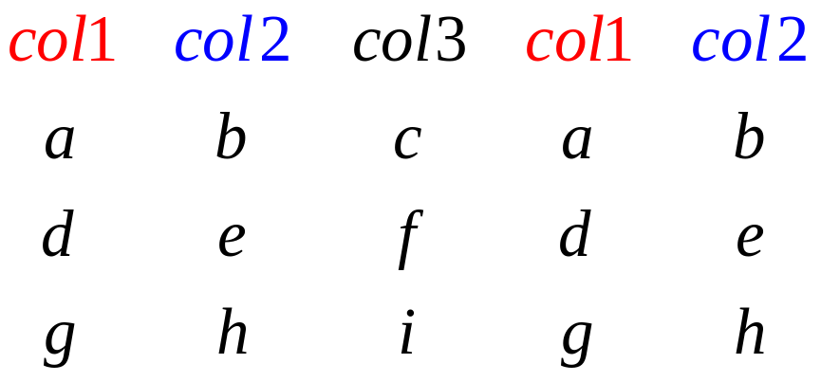
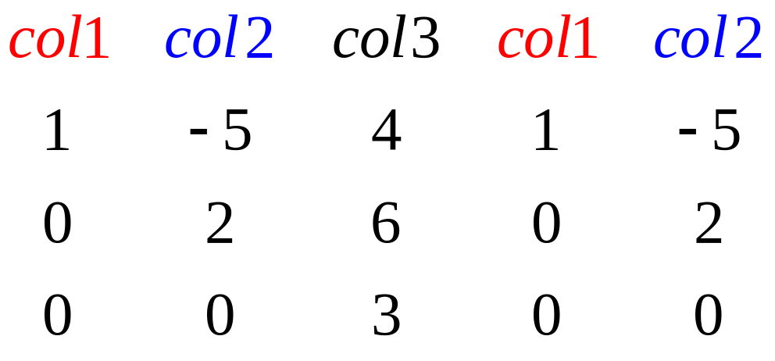
The determinant of 3x3 matrix
-
-
-
+
+
+

Slide 6
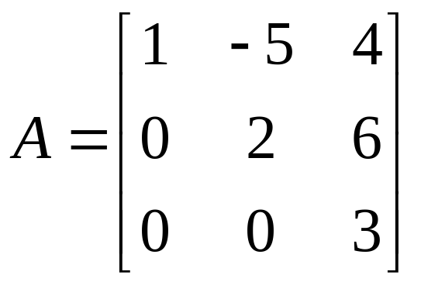
Find detA if
-
-
-
+
+
+
Note that : only use with 3x3 matrices

Slide 7
How to define the determinant of an mxm matrix?
Notes:
All the matrix should be taken determinant the matrix must be square.

Slide 8
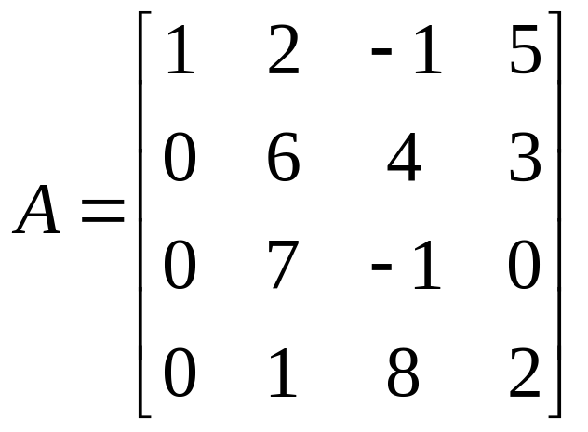
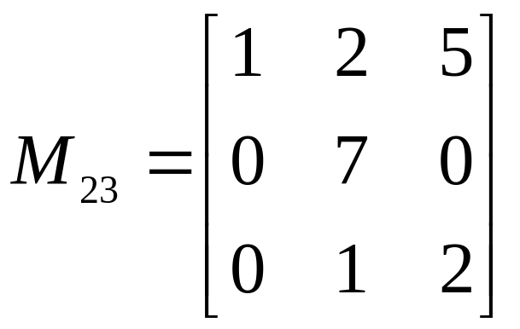
The (i,j)-cofactor
(phần phụ đại số)
If A is an mxm matrix then the (i,j)-cofactor of A is defined by
A_{ij}=(-1)^{i+j}det(M_{ij})
M_{ij} is the (m-1)x(m-1) matrix obtained from A by deleting row i and column j of A
For example, A₂₃=(-1)²⁺³det(M₂₃)=-14

Slide 9
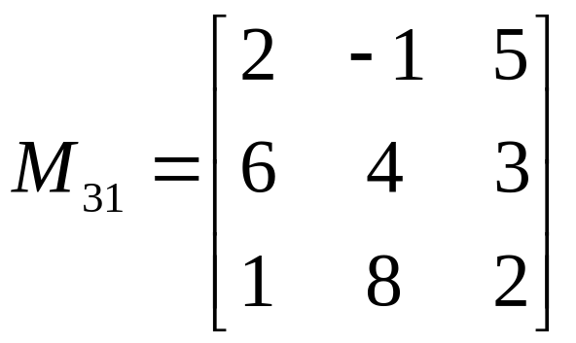

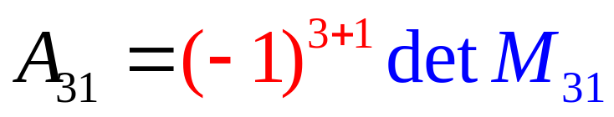

Slide 10
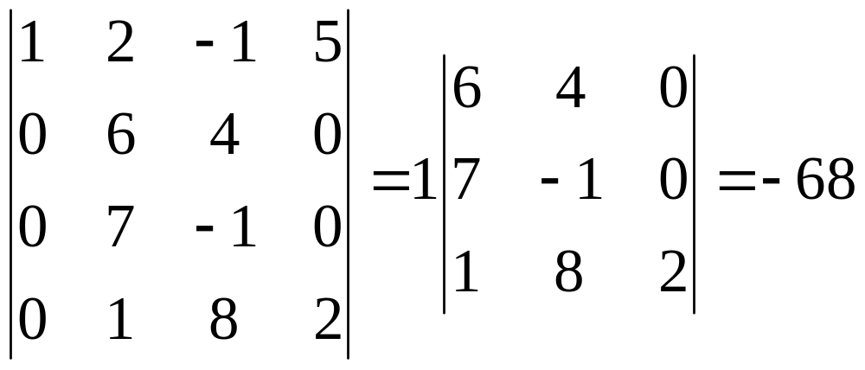
Definition
If A is an mxm matrix then the determinant of A is defined by
detA=a_{i1}A_{i1}+a_{i2}A_{i2}+…+a_{im}A_{im}
or detA= a_{1j}A_{1j}+a_{2j}A_{2j}+…+a_{mj}A_{mj}

Slide 11
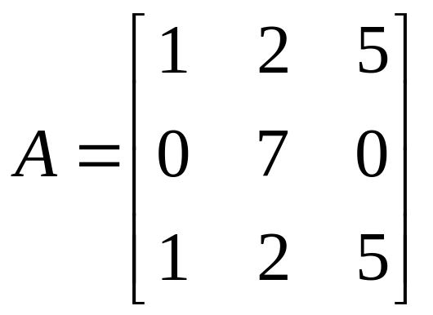
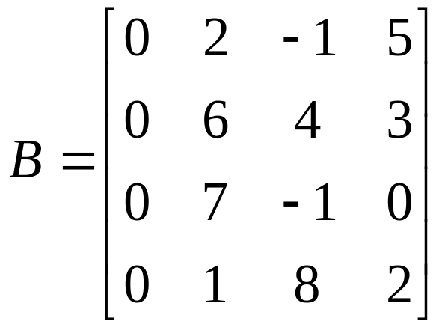
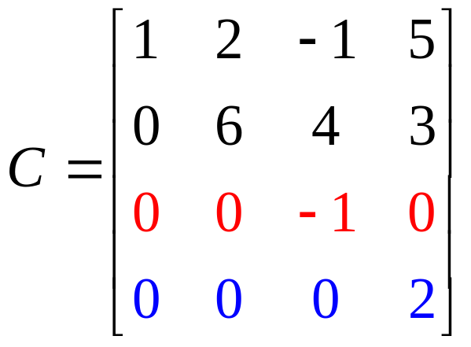
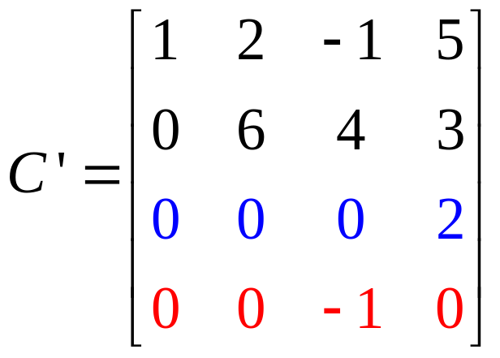
Examples
Find the determinant of the matrices

Slide 12
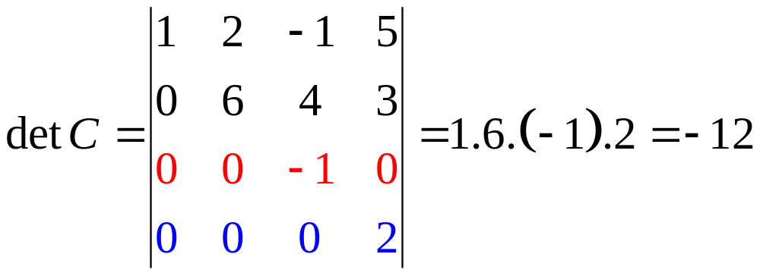
Properties
If A has one row of zeros then detA=0
If A is an triangular matrix then detA is the product of the entries on the main diagonal

Slide 13
Example
Suppose A is an triangular matrix, a₁₁=4 and c₁₁(A)=11. What is the product of all entries on the main diagonal?
A)11 B)44 C)-11 D)-44

Slide 14
Determinants and elementary operations
If B obtained from A by interchanging two rows (or columns) then detB=-detA
For example, detC’=-detC=12

Slide 15
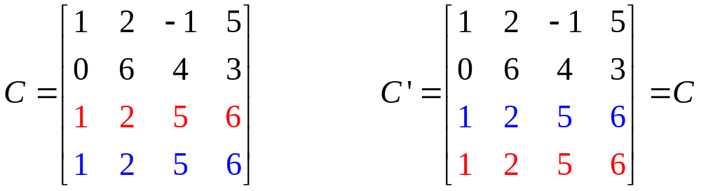
Examples
If two rows (or columns) of a matrix is the same then the determinant is zero

Slide 16
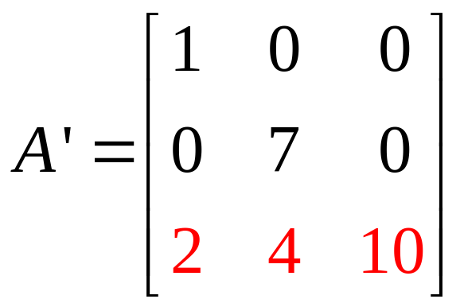
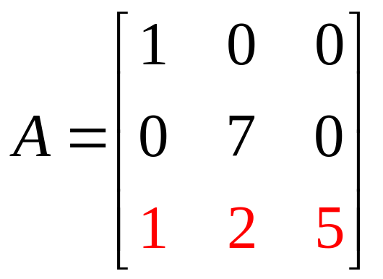
Determinants and elementary operations
If B is the matrix obtained from A by multiplying one row (or column) by a nonzero number k then detB=kdetA
For example, detA=35, detA’=2detA=2.35=70

Slide 17
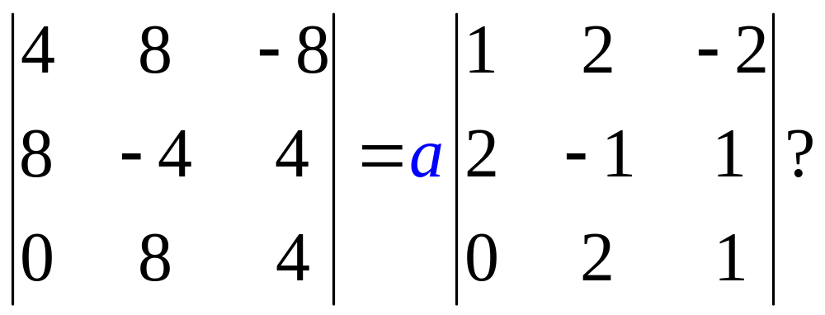
Examples
Find a such that
a) 4 b) 12 c) 48 d)64

Slide 18
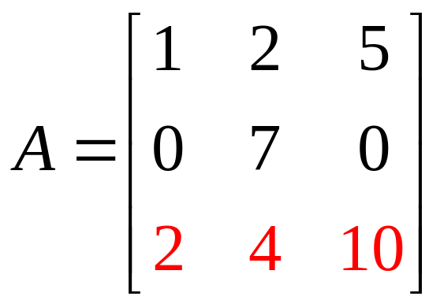
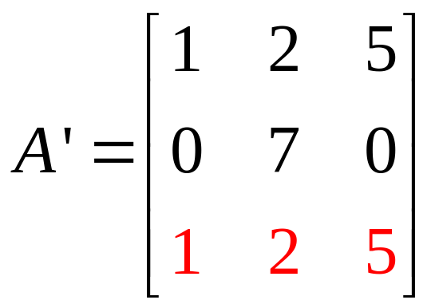
Examples
Find the determinants of the matrices

Slide 19
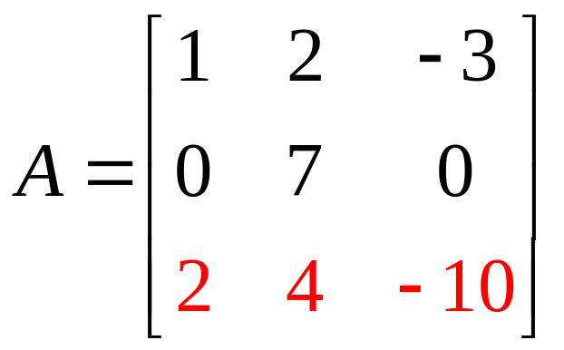
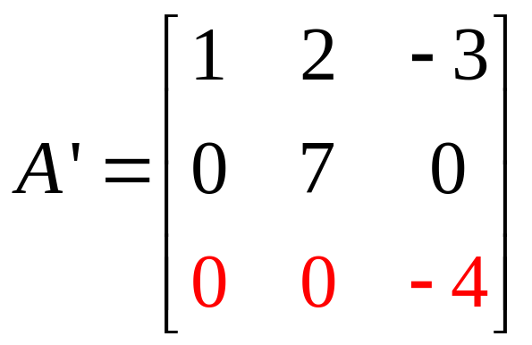
Determinants and elementary operations
If B is the matrix obtained from A by adding a multiple of one row (or column) to another row (or column) then detB=detA
For example,

Slide 20
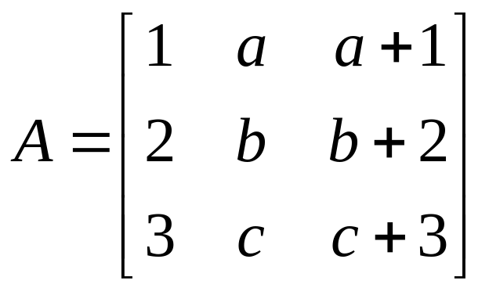
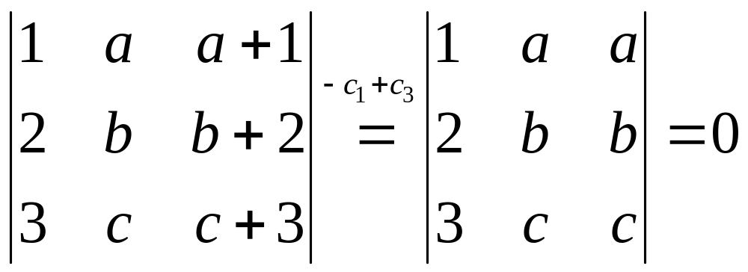
Examples
Find the determinants of the matrices

Slide 21
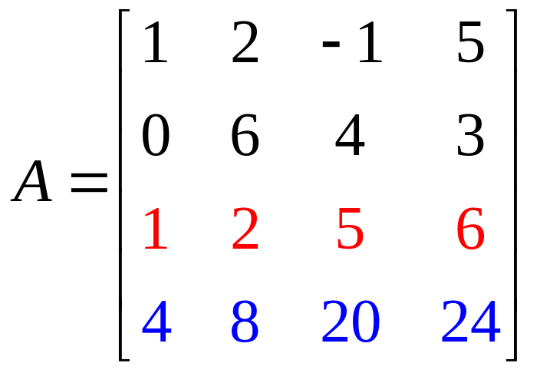
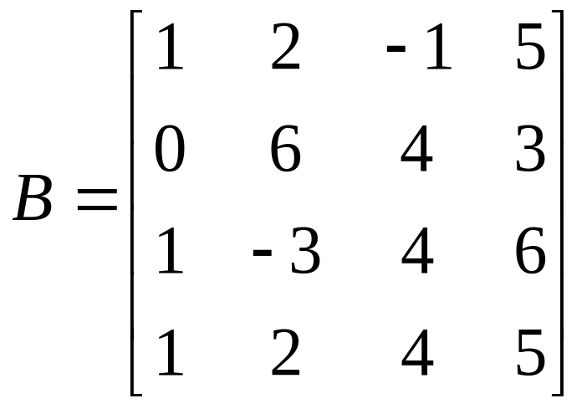
Examples
Find DetA and DetB:

Slide 22
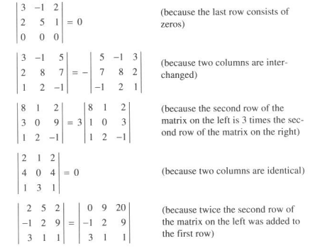


Slide 23
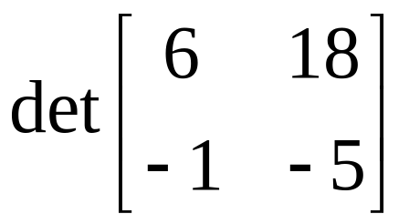
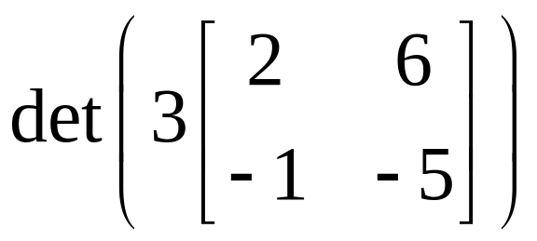
Example
Find
and compare with ?

Slide 24
Theorem
detA=det(A^{T})
det(AB)=detA.detB
If A is an nxn matrix then det(kA)=k^{n}detA
Note that det(A^{k})=(detA)^{k}

Slide 25
Example
Show that if A is an invertible matrix then
det(A⁻¹)=1/detA

Slide 26
Example
Let A is a nxn matrix, k is a scalar.
Which of the following are false?
det(A^{T})=detA b) det(AB)=detAdetB
c) det(A+B)=detA+detB d) det(kA)=kdetA
e) det(kA)=k^{n}detA

Slide 27
Example
Let A and B are nxn matrix. Which statement is false?
det(A⁻¹BA)=detB b) det(AB⁻¹A⁻¹B)=1
c) detAdetA⁻¹=1 d) detAdetA^{T}=1
e) det(A^{T}B)=det(B^{T}A)

Slide 28
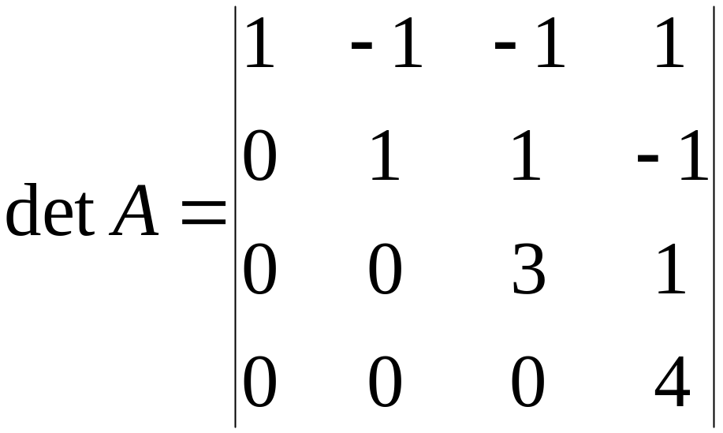
Example
detA=12 and det(A⁻¹)^{T}=12
b) detA=12 and det(A⁻¹)^{T}=1/12
c) detA=1/12 and det(A⁻¹)^{T}=12
d) detA=1/12= det(A⁻¹)T

Slide 29
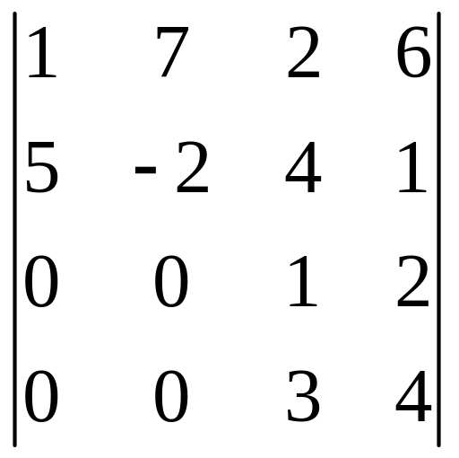
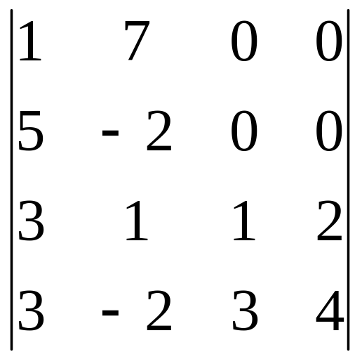
Determinant with block
Compute

Slide 30
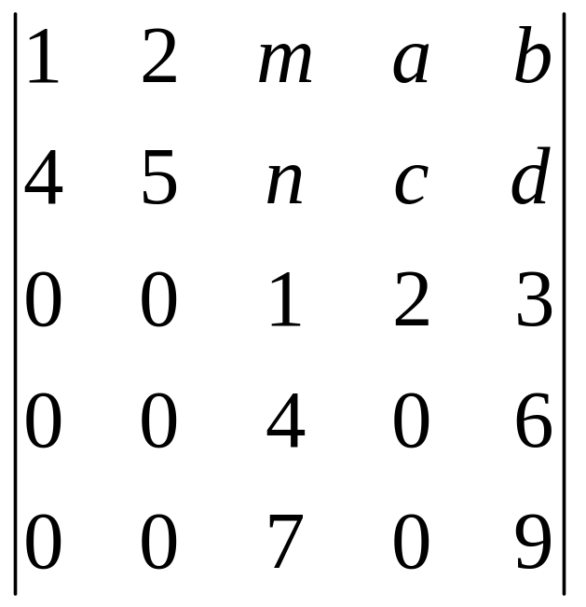
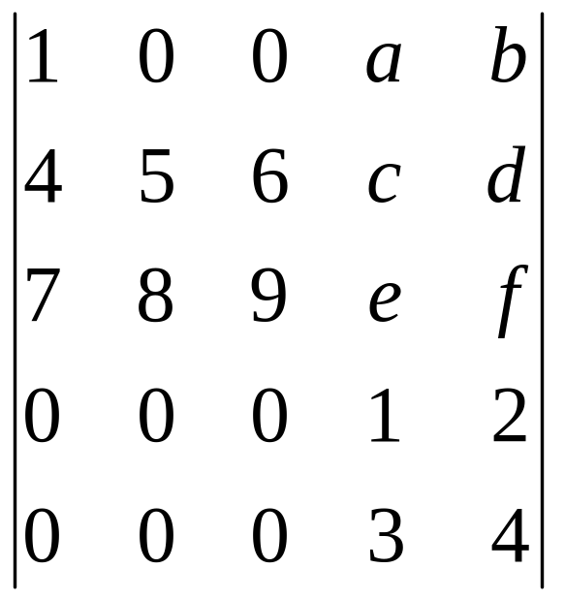
Determinant with block

Slide 31
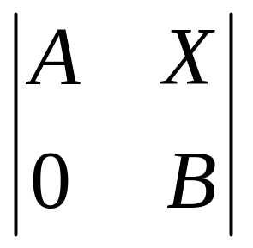
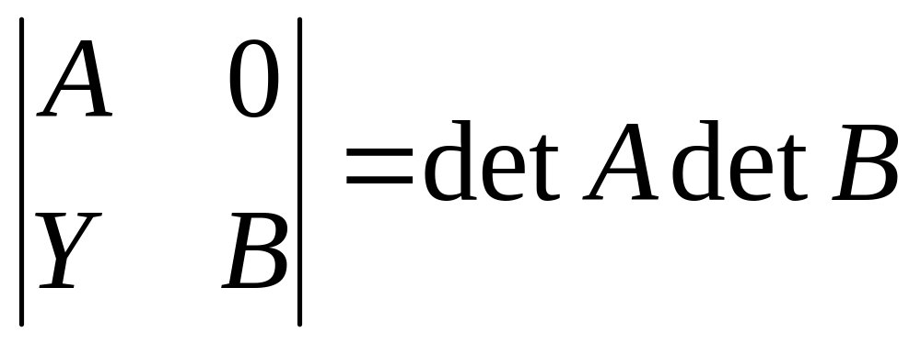
Determinant with block
Not need be a square matrix
Square matrix
Square matrix

Slide 32
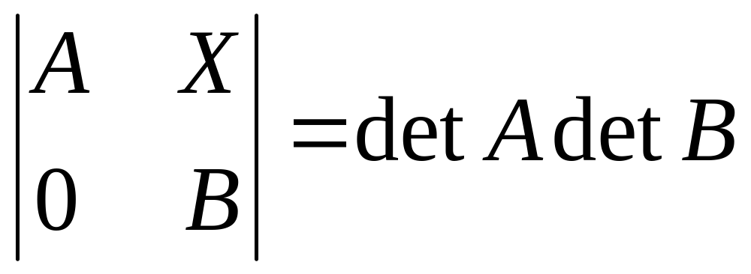
Determinant with block

Slide 33

3.2.Determinant and Matrix Inverses
If A is invertible then A→Identity matrix
If detA ≠0 and A→B by elementary operations then detB ≠0
A is invertible iff detA≠0
Cramer’s Rule
Give a formula to find A⁻¹

Slide 34
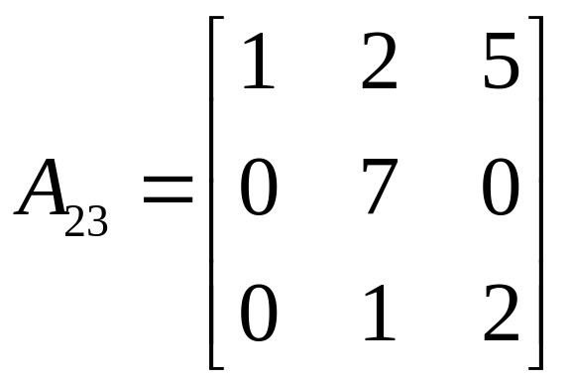
(i,j-Cofactor
(phần phụ đại số)
c_{ij}=c_{ij}(A)=(-1)^{i+j}det(A_{ij}) ( it is a number)
A_{ij} is the matrix obtained from A by deleting row i and column j

Slide 35

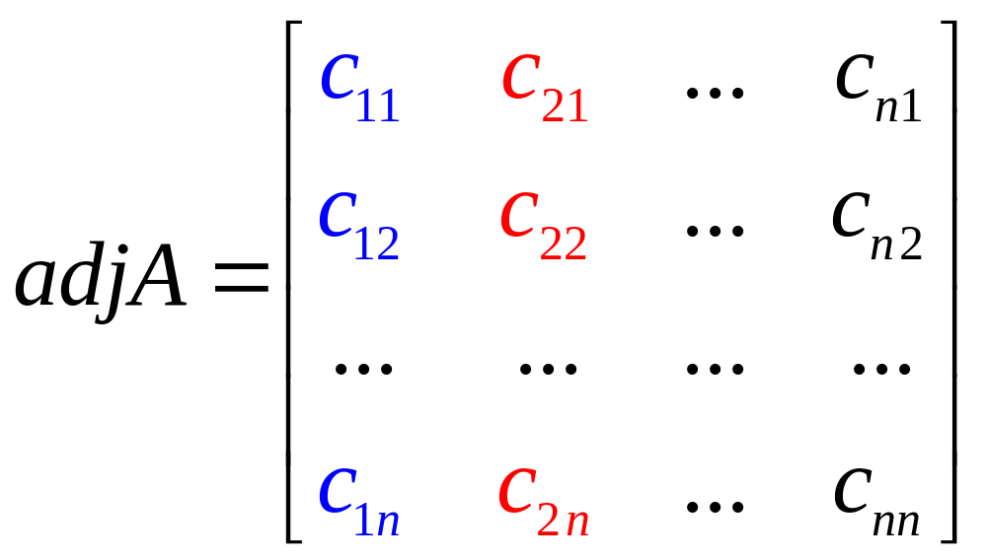
Adjugate matrix
The adjugate matrix of A is the matrix

Slide 36

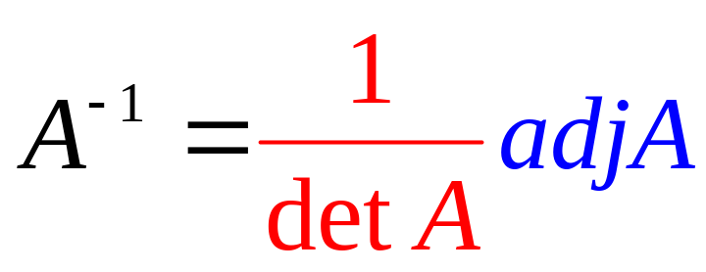
Theorem of Adjugate Formula
If A is any square matrix, then
A(adjA)=(detA)I
In particular, if detA≠0 then A is invertible and
Note that […]

Slide 37
Example
Let A be a nxn matrix with detA=3.
Find det(adjA)?
1/3 b)1/2 c)2 d) 3
e) 3^{n-1}

Slide 38
Example 7 p.121

Slide 39
Execises 1 p.126

Slide 40
Cramer’s Rule
Cramer’s system: system of n equations involving n variables and has unique solution
So, the coefficient matrix is invertible
A is invertible iff detA≠0

Slide 41
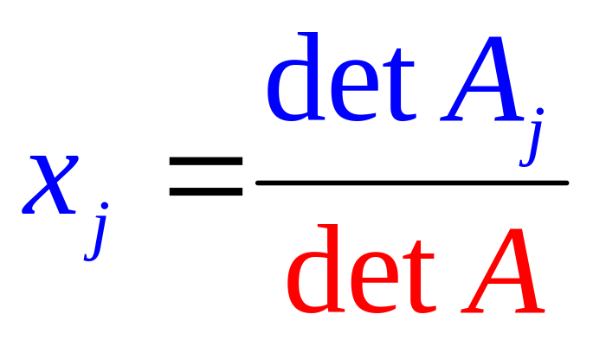
Cramer’s Rule
Consider the matrix equation AX=B where A is an invertible square matrix, X=[x₁ x₂ … x_{n}]^{T}. That means, AX=B is a Cramer’s system. Then the system has unique solution given by
?
Notes:
Cramer’s rule enabled us to calculate x₁ here without computing x₂ or x₃. This might seem an advantage, but the truth of the matter is that, for large systems of equations, the number of computations needed to find all the variables by the Gaussian algorithm is comparable to the number required to find one of the determinants involved in Cramer’s rule, or the matrix of system is not invertible and even the coefficient matrix is not square.

Slide 42
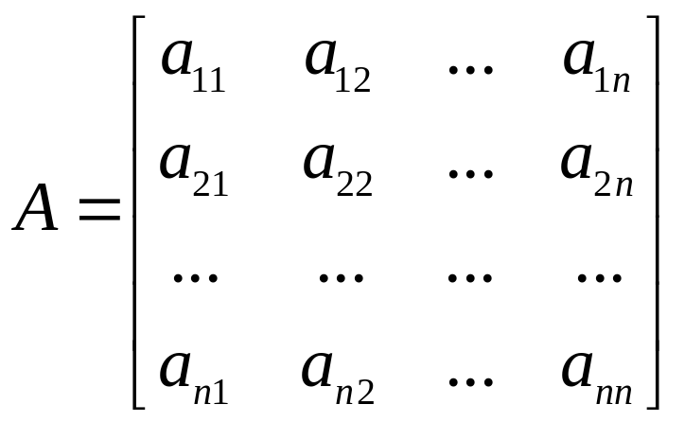
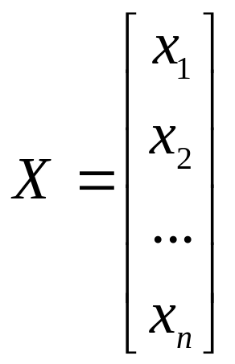
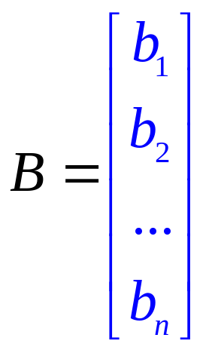
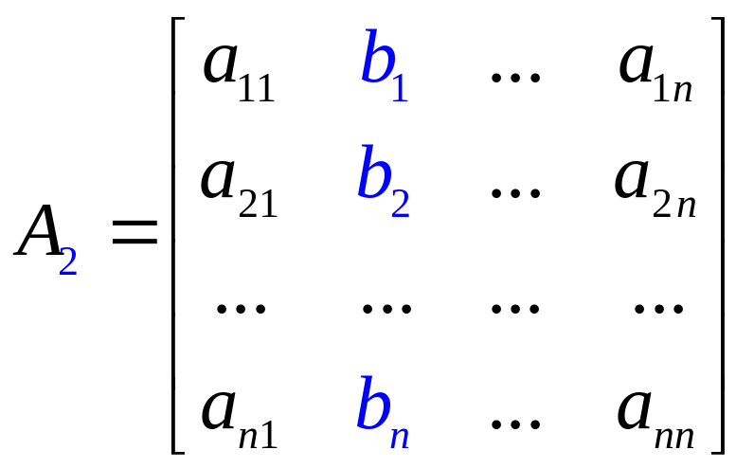
Cramer’s system: AX=B

Slide 43
Example 9 p.123
Note that […]
Cramer’s rule enabled us to calculate x₁ here without computing x₂ or x₃. This might seem an advantage, but the truth of the matter is that, for large systems of equations, the number of computations needed to find all the variables by the Gaussian algorithm is comparable to the number required to find one of the determinants involved in Cramer’s rule, or the matrix of system is not invertible and even the coefficient matrix is not square.

Slide 44
Example
Look at the following statements and choose the correct answers:
If detA=0, is it true that AX=B has no solution?
(ii) If detA=0, is it true that rankA=0?
(iii) If detA is not 0, is it true that A is invertible?
(iv) If A is nxn matrix, and the equation AX=B has more than
one solution, is it true that detA=0?
a) yes, no, no, yes. b) yes, yes, no, yes.
c) no, no, yes, yes. d) no,yes,yes,no.
e) yes, no, yes, yes.

Slide 45
The following statements are equivalent
3.3. Diagonalization and Eigenvalues
A is invertible
detA≠0
The matrix equation AX=B has unique solution
The homogeneous system AX=0 has only trivial solution
A→Identity matrix by elementary operations

Slide 46
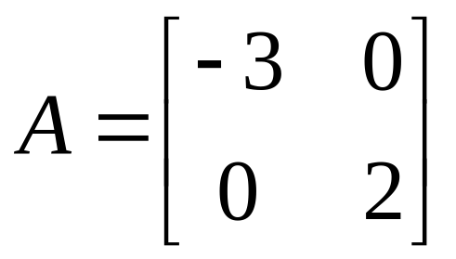


Example
Compute A²,A³, and A²⁰⁰⁹ if

Slide 47


Diagonal matrices
An nxn matrix is called diagonal matrix if all its entries off the main diagonal are zeros
For example

Slide 48


Theorem
If A is an nxn matrix and P is an invertible nxn matrix then

Slide 49


Objective
Find the invertible matrix P such that
P⁻¹AP is a diagonal matrix
Then,

Slide 50




Example

Slide 51


How to find P?

Slide 52

Eigenvalues and eigenvectors
If A is an nxn matrix, a number λ is called an eigenvalue of A if AX=λX for some column X≠0
Such a nonzero column X is called an eigenvector of A corresponding to λ, or a λ-eigenvector for short
eigenvalue
λ-eigenvector

Slide 53



Example
Find an eigenvalue and eigenvector for the matrix
eigenvalue
eigenvector

Slide 54



How to find P?
X_{i} are nonzero columns

Slide 55

Characteristic Polynomial
The characteristic polynomial of an nxn matrix A is defined by
P_{A}(x)=det(xI - A)
For example, if

Slide 56


Example
Find the eigenvalues and eigenvectors of the matrix
The characteristic polynomial of A is

Slide 57



we solve the equation
The solution is
t is arbitrary
The eigenvectors of A corresponding to λ₁=0 is
t≠0

Slide 58



we solve the equation
The solution is
t is arbitrary
The eigenvectors of A corresponding to is
t≠0

Slide 59


When is A diagonalizable?
Theorem
A is diagonalizable iff every eigenvalue of multiplicity m
yields exactly m basic eigenvectors, that is,
iff the general solution of the system
has exactly m parameters.

Slide 60


3.4. An Application to Linear Recurrences

Slide 61
Linear Dynamical System
Definition
V₀,V₁,V₂,… are columns such that
V₀ is known and
V_{k+1}=AV_{k} for each k>=0
matrix recurrence

Slide 62


Slide 63


Slide 64


Slide 65
An Application to Linear Recurrences

Slide 66



Slide 67



Slide 68



Slide 69


Slide 71
Thanks

